Slide 1
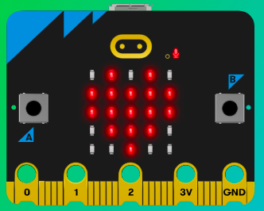
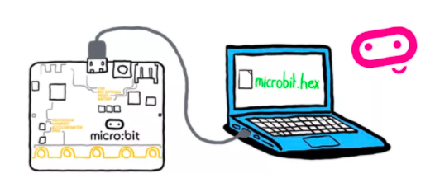
MicroMakers!
KIDS’ MAKER CLUB OF WASHINGTON, DC
Meet Up #23

Slide 2
REVIEW!
Notes:
LEDs, Buttons, Light Sensor

Slide 3
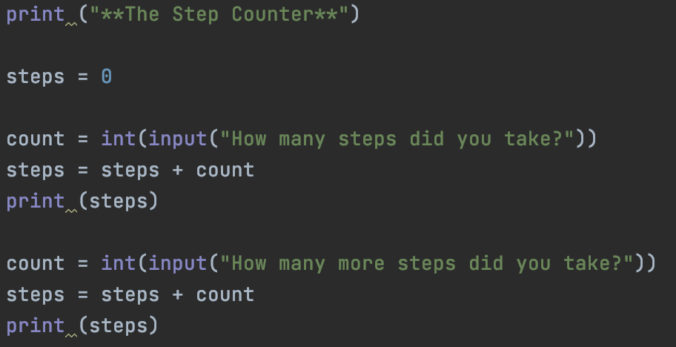
VARIABLES
Python, MakeCode, Scratch

Slide 4
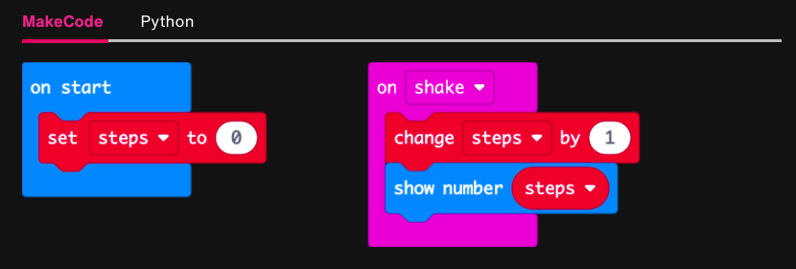
VARIABLES
Python, MakeCode, Scratch

Slide 5
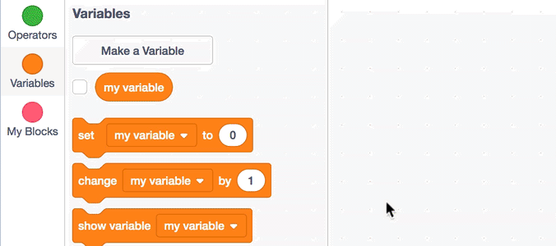
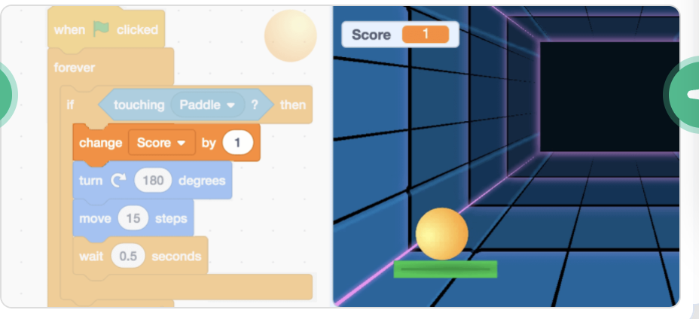
VARIABLES
Python, MakeCode, Scratch

Slide 6
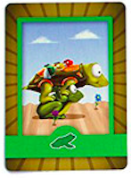
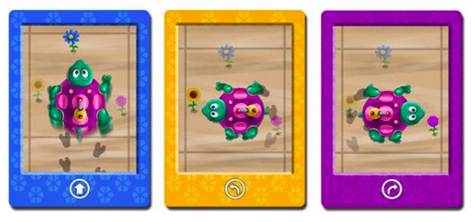
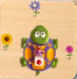
FUNCTIONS
Turtles, Make Code, Python
=

Slide 7
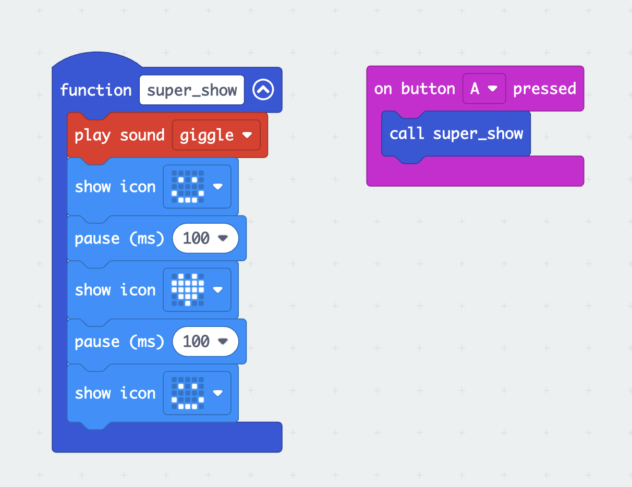
FUNCTIONS
Turtles, Make Code, Python

Slide 8
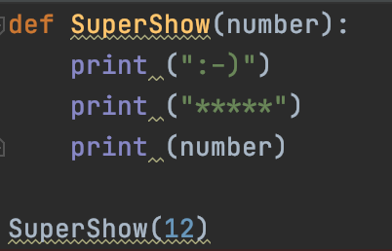
FUNCTIONS
Turtles, Make Code, Python

Slide 9
PROGRAMMING
Components
Only three types of instructions are needed to write any program:
sequence: first do this, then do that
selection: IF such-and-such is the case, THEN do this, ELSE do that
repetition: WHILE such-and-such is the case, DO this.
Corrado Böhm and Giuseppe Jacopini's insight: there are only three ways of combining these actions (into more complex ones) that are needed in order for a computer to do "anything".^{[63]}

Slide 10
PROGRAMMING
SEQUENCE: First do this, then do that
1 print (“Hello!”)
2 print (2+3)
3 height = int(input(“How tall are you?\n”))

Slide 11
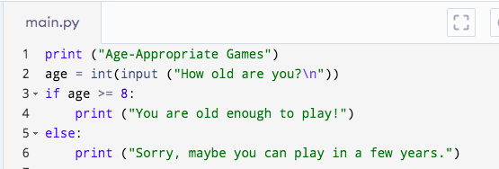
PROGRAMMING
SELECTION: If <something is true>, do this, else do that.

Slide 12
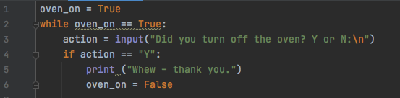
PROGRAMMING
REPETITION: WHILE <something is true>, do this.

Slide 13
BRINGING IT ALL TOGETHER
Notes:
LEDs, Buttons, Light Sensor

Slide 14
PRIZE CHART CALCULATOR
ITEM | # | PRICE / ITEM
Bubbles | 4 | $500
Bracelets (4-5 per pack) | 4 | $100
Ring Pops | 4 | $500
Galaxy Slime | 5 | $200
Mystery Eggs | 5 | $200
Mochi Rings | 10 | $100
Misc. | 2 | $300

Slide 15
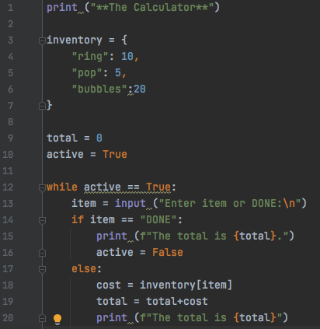

Slide 16
MOTORS + SERVOS!
Notes:
LEDs, Buttons, Light Sensor

Slide 17
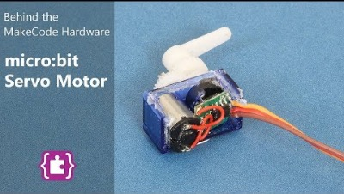
Introduction to Servos

Slide 18
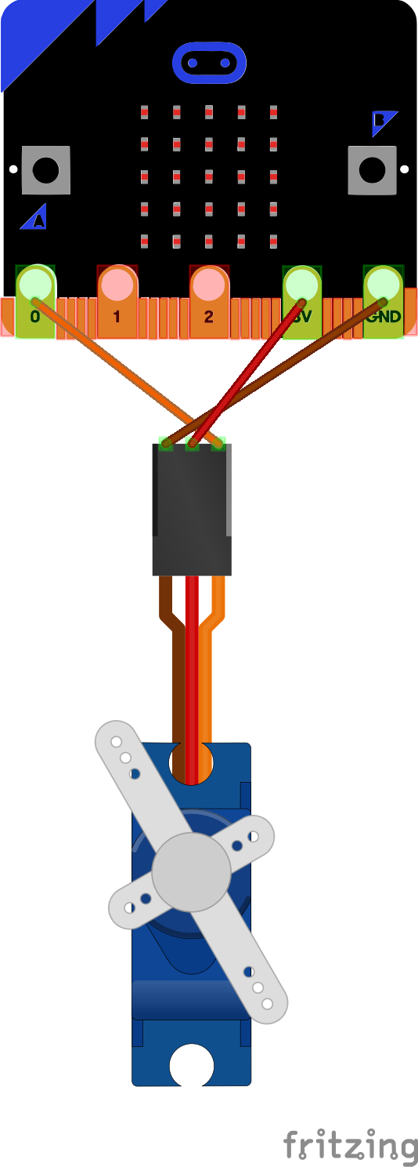
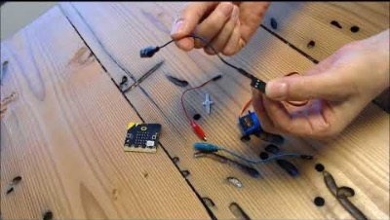
Introduction to Servos

Slide 19
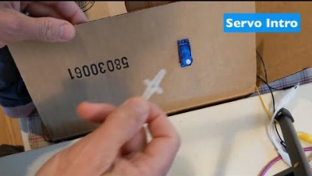

Slide 20
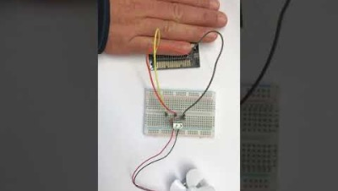
Step 1: The Project
Micro:bit Heat Activated Fan
What is it?
Create a fan that turns on in the heat!
What do I need?
Micro:bit
Servo (continuous)
3 Alligator Clips (Pin + Clip Style)
Paper
Washi Tape

Slide 21
Step 2: How Does it Work?
Pins for inputs, ground, and for power
Connect your servo to the correct pins:
Brown -> Ground
Red -> Power (3 volts, or 3V)
Orange -> Input/Output Pin (P0, P1, or P2)
Remember, with the Ground pin, we are completing the circuit.
The Power pin feeds power from the battery or your computer to the servo.
With the Input/Output pin, we are sending information from the Micro:bit to the servo

Slide 22
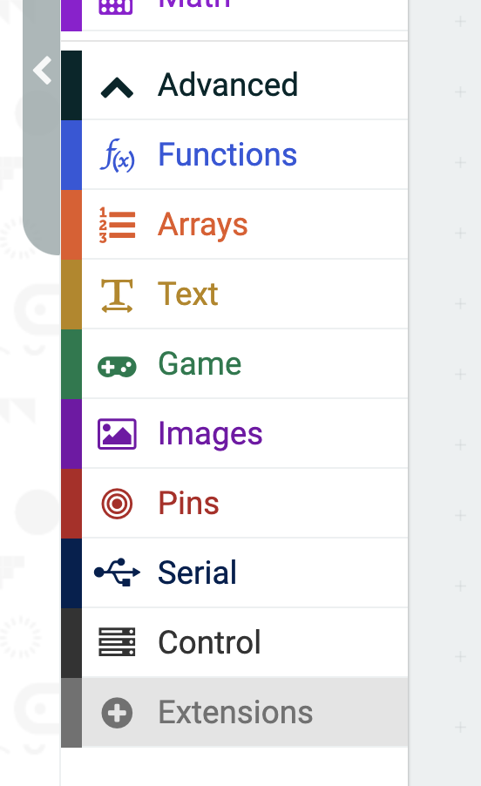
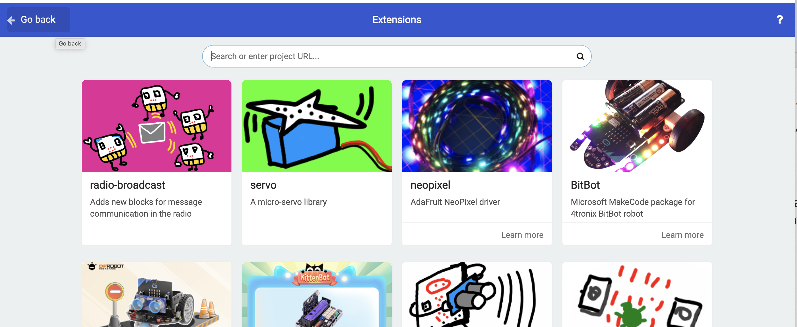
Step 2: How Does it Work?
Pins for inputs, ground, and for power
Add the “Servo” extension (or “library”) to your MakeCode project

Slide 23
Step 2: How Does it Work?
Pins for inputs, ground, and for power
Your Micro:bit should continuously check and record the temperature.
When the temperature gets warm, your fan should turn on.

Slide 24
Step 3: Pseudocode It!
When you turn on your micro:bit, your micro:bit should beep and show a picture so you know that your app has started correctly.
On start
Show <current temperature>

Slide 25
Step 3: Pseudocode It!
Forever….
If temperature > 25 degrees C:
Rotate servo
Else:
Stop servo

Slide 26
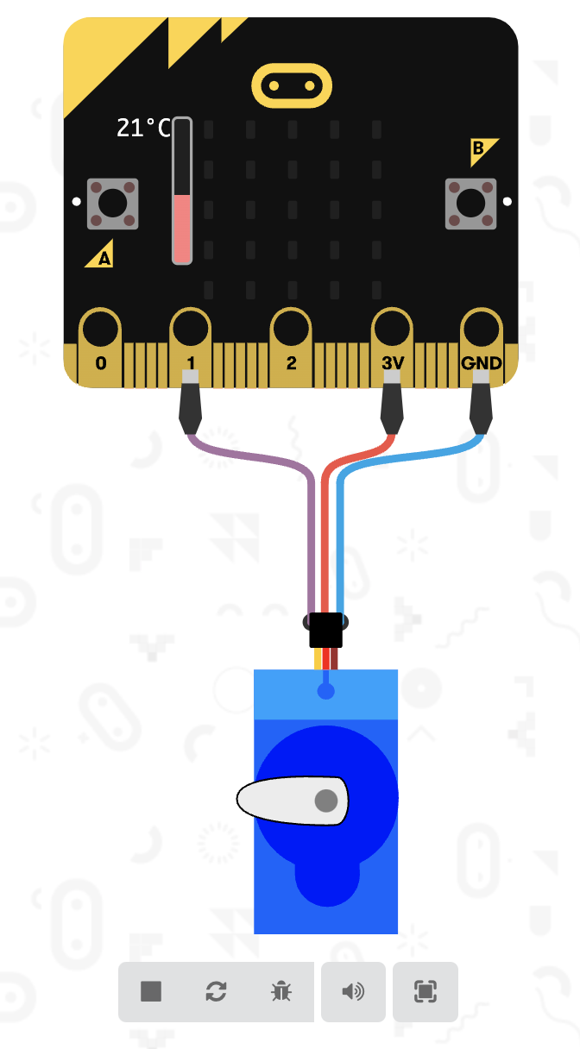
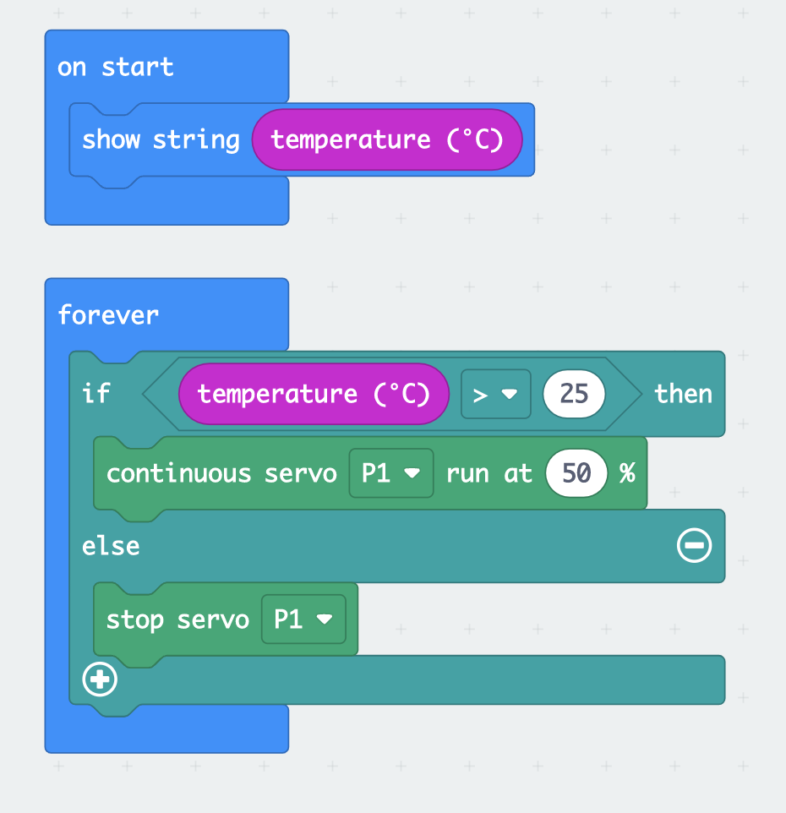
Step 3a: Cheat!

Slide 27
Step 3: Make it and Code It!
Attach your servo to the Micro:bit, making sure you are connecting the right wires to the right pins.
Cut out your fan blades.
Use your pseudo code to program your Micro:bit to control the fan.
Pop Quiz: What are the inputs and what are the outputs in this program?

Slide 28
Step 4: Share Your Creation!

Slide 29
Step 5: Improve it!
See if you can make your fan respond to other inputs (e.g., sound, light)

Slide 30
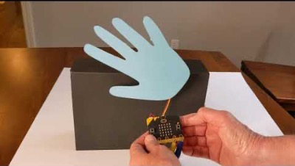
Step 1: The Project
Micro:bit The Princess Hand Waver
What is it?
Create an automatic waving hand.
What do I need?
Micro:bit
Servo (positional)
3 Alligator Clips (Pin + Clip Style)
Paper
Washi Tape

Slide 31
Step 2: How Does it Work?
Pins for inputs, ground, and for power
Connect your servo to the correct pins:
Brown -> Ground
Red -> Power (3 volts, or 3V)
Orange -> Input/Output Pin (P0, P1, or P2)
Remember, with the Ground pin, we are completing the circuit.
The Power pin feeds power from the battery or your computer to the servo.
With the Input/Output pin, we are sending information from the Micro:bit to the servo

Slide 32
Step 2: How Does it Work?
Pins for inputs, ground, and for power
Add the “Servo” extension (or “library”) to your MakeCode project

Slide 33
Step 2: How Does it Work?
Pins for inputs, ground, and for power
When you press A, your hand should wave 5 times.(short parade)
When you press B, your hand should wave 10 times (long parade)

Slide 34
Step 3: Pseudocode It!
When you turn on your micro:bit, your micro:bit should beep and show a picture so you know that your app has started correctly.
On start
Play <sound>
Show <picture>

Slide 35
Step 3: Pseudocode It!
When A button pressed:
Repeat the following 5 times:
Turn servo to 45 degrees
Pause for ½ second
Turn servo to 135 degrees
Pause for ½ second
When B button pressed:
Repeat the following 10 times:
Turn servo to 45 degrees
Pause for ½ second
Turn servo to 135 degrees
Pause for ½ second

Slide 36
Step 3: Make it and Code It!
Attach your servo to the Micro:bit, making sure you are connecting the right wires to the right pins.
Cut out your waving hand and tape to the servo.
Use your pseudo code to program your Micro:bit to control the hand with the buttons.
Pop Quiz: What are the inputs and what are the outputs in this program?

Slide 37
Step 4: Share Your Creation!

Slide 38
Step 5: Improve it!
See if you can make your hand respond to other inputs (e.g., light, touch, or sound)!

Slide 39
TIME TO PUT AWAY OUR THINGS!
Neat and tidy, please!
Let’s leave this beautiful room as lovely as we found it!

Slide 40

UNTIL NEXT TIME….
MicroMakers!
Slides and Script: Holly Krambeck (learningpython64@gmail.com)

